Slide 1
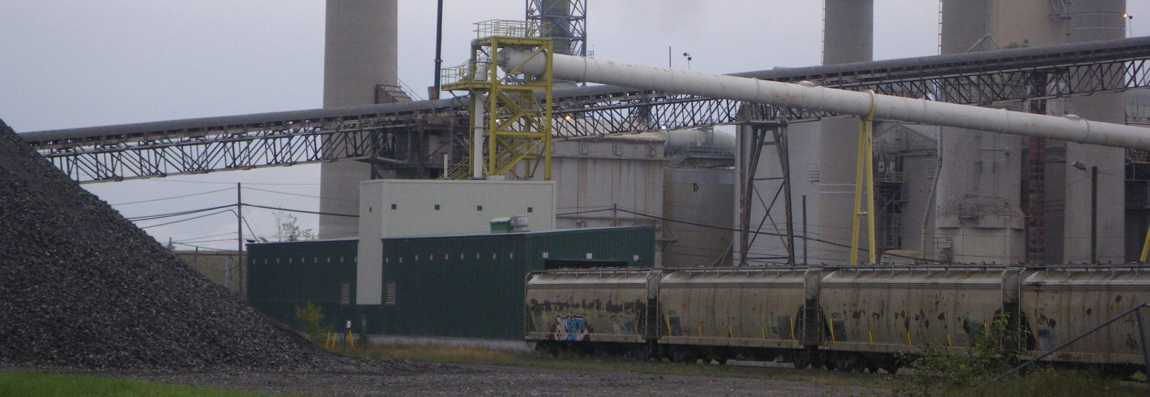
Heat and Mass balance Solution
Technical Development Program SPREAD 2016

Slide 2
Task 1: Mass balance
Compare the following dust measurements and integrate it in the balance
Close mass balance error

Slide 3
Finalization of mass balance:
Dust main filter:
In direct operation 2 h after raw mill stop
Two different measurements have been done:
1 m³ bin was filled in 8 minutes, mass 1250 kg
This measurement was repeated 3 times always with the same result.
20 t truck was filled in 84 minutes This measurement could only be done once due to the generation of fugitive dust, the Environmental manager forbid to repeat the measurement
Task: Which measurement do you consider? Fill in the value in cell D93! Check next page for further info!

Slide 4
Mass flows additional info
Clinker:
Clinker was separated for 24 h using the off-spec silo
This silo was continuously discharged to trucks
The trucks were weighed on the calibrated weigh bridge: 4029.6 t
Petcoke:
The Pfister feeders were calibrated before the balance (with loss of weight of feed bin) and calibration showed no significant error
For the balance duration, the average are: MB: 7 t/h, PC: 10.3 t/h
AFRs:
The new dosing equipment performance test has recently been done, where the feed amount was discharged to trucks to cross-check dosing accuracy, which resulted in minimal errors. The measured values were entered in the balance
Kiln feed:
The impact flow meter was calibrated beforehand (with loss of weight of feed bin) and the kiln feed bin was even cleaned on the outside from accumulated dust during the calibration

Slide 5
Task 1: Mass balance SOLUTION!
Dust measurements: Which one to take?
Truck 20 t in 84 min→ 14.3 t/h
Other measurement will be affected by the cleaning cycles, resulting in 9.4 t/h with a cyclone efficiency of 97% which is not realistic
Always choose longest possible period (e.g. 1 truck to obtain multiple of cleaning frequency to avoid erroneous readings
Kiln feed amount:
Since dust and clinker are weighed out accurately the kiln feed amount needs to be adjusted – removal of dust from weigh-frame after calibration increases actual throughput (corrected 269 t/h)
With lower dust value, the mass balance would close better but dust amount is too low.

Slide 6
Task 2: Cooler air balance
Insert degree of calcination (Cell I430) of hot meal and discuss impact on cooler air balance
Insert the oxygen value after pre-calciner in balance (Cell I431) in the balance
Insert cooler waste air volume to close cooler air balance error (Cell I281)

Slide 7
Calcination degree
Determine the calcination degree according to the lab results:
LOI:
Kiln feed 35%
Main filter dust 36.5%
Hot meal 2.6 %
Clinker 0%
Enter correct value in cell I430
Formula → “PPE Reference guide”

Slide 8
Preheater exit, Precalciner measurements
Preheater exit:
O₂
Permanent O₂ measurement was cross-checked during the Balance, no error was found.
24 h average value from the fix installed analyzer is 3%
Temperature:
Fix installed temperature measurement was cross-checked, no error was found
24 h average taken for balance 340°C.
Pre-calciner exit O₂ (Cyclone 5 gas exit)
Only one manual measurement available: 5%. Repetition of this measurement was not possible due to broken probe.

Slide 9
Waste air, cooling air flow, tertiary air
Waste air:
Temperature is 24 h average of CCR value which was cross-checked beforehand: 300°C
Waste air flow was measured 3 times: result = 190’000 Nm³/h
Cooling air flow
Air flow set points of the fans were kept constant and in automatic control during the whole balance period
Each fan was measured once with the anemometer at the inlet.
In two fans, error > 5% to the value from the CCR were detected and confirmed with a repetition of the measurement. The manually measured values were inserted in the balance

Slide 10
Task 2: Cooler air balance SOLUTION!
Calcination degree: 95% (page 43 of PPE Reference Guide)
Measured value for waste air 190’000 Nm³/h does not close balance
Disregard measurement?
Other solution?
Errors:
The manual measurement of 5% O₂ measured after calciner cannot be correct because of 3% O₂ at preheater exit. (No organics in kiln feed, no post combustion in preheater tower)
Solution
Go and measure again. This time 2% O₂ have been measured after the lowest stage cyclone.
Then also the 190’000 Nm³/h will close the cooler air balance

Slide 11
Task 3: Cooler heat balance
Insert clinker inlet temperature (at kiln discharge) (Cell I447)
Insert tertiary air temperature (Cell I457) in balance
Insert clinker temperature (Cell D110) in balance
Close balance error according to procedure

Slide 12
Temperature measurements
Clinker inlet temperature
Pyrometer measurement showed 600°C but is was only possible to measure 3 times quickly in order not to burn the equipment. The equipment was the same as used for the kiln shell radiation measurement.
Which value do you consider for the balance? Enter it in cell I446
Tertiary air temperature
CCR value is 800°C (24 h average)
Measured value (4 times during balance) 850°C (CCR value 740°C at the times of the measurements)
Which value do you consider?

Slide 13
Temperature measurements SOLUTION!
Clinker inlet temperature
Usually no measurement is done, in order to compare cooler efficiencies usually 1450°C utilized.
Exceptions: Satellite Cooler/Long wet/dry kilns: 1200°C
Kiln shell pyrometers can usually only measure up to 600°C, for this reason the instrument just showed the maximum temperature
Tertiary air temperature
Offset of 110°C from CCR to real temperature
800°C + 110°C → 910°C
With the other solutions, secondary air and tertiary air temperatures are not the same despite the kiln hood extraction of the tertiary air.

Slide 14
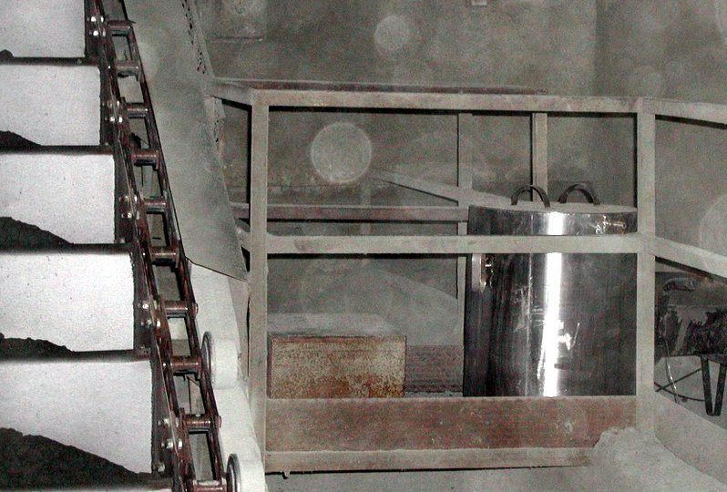
Clinker temperature
Measured with a box
Each hour filled from pan conveyor
Max Temp recorded with data logger
Calculate Average temperature insert it in Heat balance (Cell D110)

Slide 15
Clinker temperature SOLUTION!
Measured with a box
Each hour filled from pan conveyor
Max Temp recorded with data logger
Eliminate clinker temperature peaks → 160°C

Slide 16
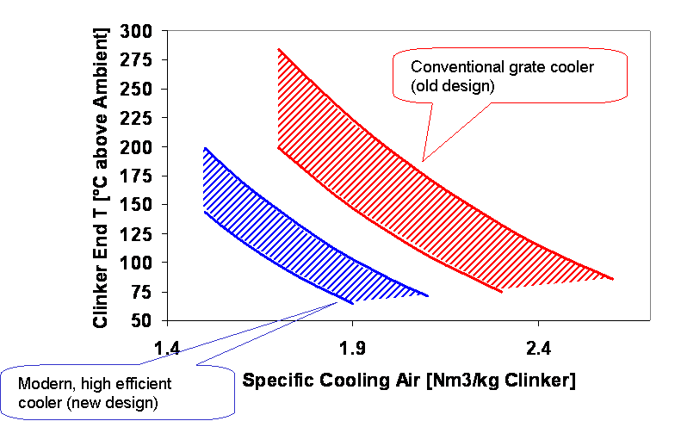
Cooler heat balance SOLUTION!
Close balance by adjusting secondary air temperature to 910°C
Same value as Tertiary air as it is extracted from same point
Cooler is not in usual range of operation → improvement potential available
With peaks
Without peaks
Graph similar to PPE reference guide
Target

Slide 17
Task 4: Kiln heat balance
Check now if kiln heat balance closes
Check measurements again for correctness, if necessary
Discuss measurement errors / certainty of values
Discuss: heat consumption value = fuel input

Slide 18
Task 4: Kiln heat balance SOLUTION!
After former adaptations, no further adaptations necessary
Small error remains (-50 kJ/kg cli)
How to improve accuracy?
Discuss on measurement errors / certainty of values
Output usually better known than inputs, so rather adjust fuels than other items in that stage
Error range acceptable = + 5% = +167.5 kJ/kg → Range: 3’183 – 3’518 kJ/kg cli → Value of balance?
Discuss heat consumption value = fuel input
What about values as seen in “total of balance”?
What about TOC, Pyritic sulfur in kiln feed?
Error in heat balance - 50 to -100 kJ/kg → Real heat consumption might be higher.
Especially when comparing two balance make sure you compare errors and heat consumption values!

Slide 19
Kiln heat balance CONCLUSION!!
Mass balance
Error in kiln feed dosing device
Clinker cooler efficiency low
Normal cooling air volume, high clinker exit temperature
Check air distribution
Operation of cooler
Kiln heat balance
Low O2 at kiln inlet → TA damper/Restriction!

